Slide 1
Graph Traversals
Introduction
Breadth-First Traversal.
  The Algorithm.
  Example.
  Implementation.
Depth-First Traversals.
  Algorithms.
  Example.
  Implementation.
Some traversal applications:
  Connected Components
  Strongly Connected Components
  Edge Classification
Review Questions.

Slide 2
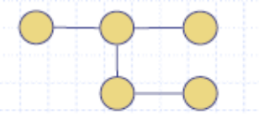
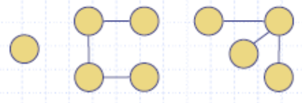
Introduction
A free tree is a connected undirected graph without a cycle.
  Note: This definition of tree is different from the one of a rooted tree
In a free tree |E| = |V| - 1
Example of a free tree:
A forest is an acyclic directed or undirected graph consisting of two or more trees
The trees in a directed forest are rooted trees
The trees in an undirected forest are free trees

Slide 3
Introduction (Cont’d)
To traverse a graph is to systematically visit and process each node in the
graph exactly once.
There are two common graph traversal algorithms that are applicable to both directed and
undirected graphs :
  BreadthFirst Traversal (BFS)
  DepthFirst Traversal (DFS)
    PreOrder DepthFirst Traversal
    PostOrder DepthFirst Traversal
Since some graph algorithms do not require all vertices of a graph to be
visited we will define both BFS and DFS such that it is possible the
algorithms:
  starting from any vertex, will not visit all vertices if the traversed graph is
  disconnected
  starting from a particular vertex, may not visit all vertices if the traversed
  graph is weakly connected
We shall define General traversal algorithms [dfsAllVertices and bfsAllVertices] that will
visit each vertex of a graph G in those algorithms that require each vertex to be visited.
These algorithms will be of the form:
for(i = 0; i < numberOfVertices; i++){
if(vertex_{i} is not visited)
dfsPreOrder(G, vertex_{i}); // or dfsPostOrder(G, vertex_{i}) or bsf(G, vertex_{i})
}

Slide 4
Introduction (Cont’d)
The BFS and DFS traversal of a graph G is not unique. A traversal depends both on the starting vertex, and on the order of traversing the adjacent vertices of each node.

Slide 5
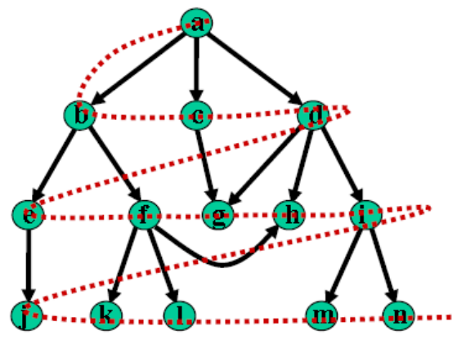
Breadth-First Traversal Algorithm
In this method, After visiting a vertex v, we must visit all its adjacent vertices w1, w2, w3, ..., before going down to the next level to visit vertices adjacent to w1 etc.
The method can be implemented using a queue.
A boolean array is used to ensure that a vertex is enqueued only once.
enqueue the starting vertex
while(queue is not empty){
dequeue a vertex v from the queue;
visit v.
enqueue vertices adjacent to v that were never enqueued;
}
Note: Adjacent vertices can be enqueued in any order; but to obtain a unique traversal, we
will enqueue them in alphabetical order.
A BFS traversal of a graph results in a breadth-first tree or in a forest of such
trees

Slide 6
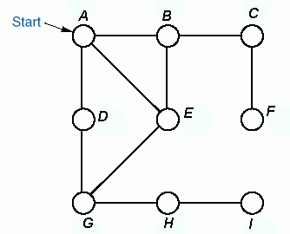

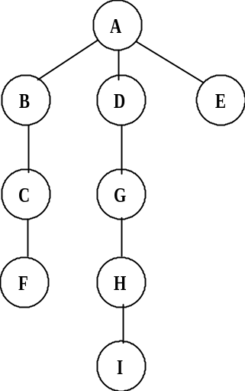

Example
Breadth-first traversal using a queue.
Queue front
BFS-tree:
Order of
Traversal
A B D E C G F H I
Queue rear
Note: The BFS-tree for undirected graph is a free tree

Slide 7
Breadth-First Traversal Implementation
public void breadthFirstTraversal(Visitor visitor, Vertex start){
boolean enqueued[] = new boolean[numberOfVertices];
for(int i = 0; i < numberOfVertices; i++) enqueued[i] = false;
Queue queue = new QueueAsLinkedList();
enqueued[getIndex(start)] = true;
queue.enqueue(start);
while(!queue.isEmpty() && !visitor.isDone()) {
Vertex v = (Vertex) queue.dequeue();
visitor.visit(v);
Iterator it = v.getSuccessors();
while(it.hasNext()) {
Vertex to = (Vertex) it.next();
int index = getIndex(to);
if(!enqueued[index]) {
enqueued[index] = true;
queue.enqueue(to);
}
}
}
}

Slide 8
Analysis of BFS
For a Graph G=(V, E) and n = |V| and m=|E|
When Adjacency List is used
  Complexity is O(m + n)
When Adjacency Matrix is used
  Scanning each row for checking the connectivity of a Vertex is in order O(n).
  So, Complexity is O(n²)

Slide 9
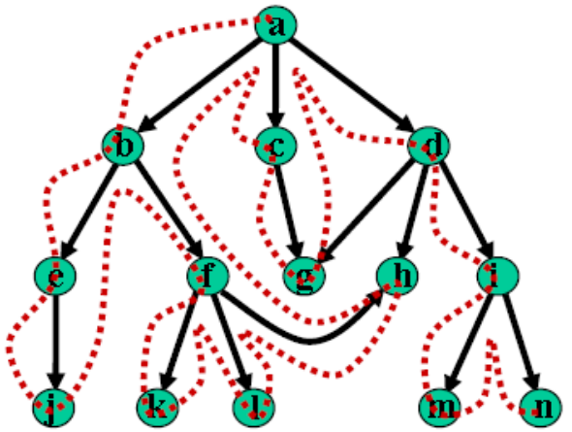
Depth-First Traversal Algorithm
A DFS starting at a vertex v first visits v, then some neighbour w of v, then some neighbour x of w that has not been visited before, etc. When it gets stuck, the DFS backtracks until it finds the first vertex that still has a neighbour that has not been visited before. It continues with this neighbour until it has to backtrack again. Eventually, it will visit all vertices reachable from v
Must keep track of vertices already visited to avoid cycles.
The method can be implemented using recursion or iteration.
The iterative preorder depth-first algorithm is:
push the starting vertex onto the stack
while(stack is not empty){
pop a vertex off the stack, call it v
if v is not already visited, visit it
push vertices adjacent to v, not visited, onto the stack
}
Note: Adjacent vertices can be pushed in any order; but to obtain a unique traversal, we
will push them in reverse alphabetical order.
A DFS traversal of a graph results in a depth-first tree or in a forest of such
trees

Slide 10
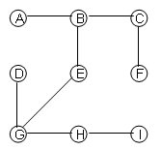
Example
Depth-first traversal using an explicit stack.
The Preorder Depth First Tree:
Order of
Traversal
A B C F E G D H I
Stack
Note: The DFS-tree for undirected graph is a free tree

Slide 11
Recursive preorder Depth-First Traversal Implementation
dfsPreorder(v){
visit v;
for(each neighbour w of v)
if(w has not been visited)
dfsPreorder(w);
}
The following is the code for the recursive preorderDepthFirstTraversal method of the AbstractGraph class:
public void preorderDepthFirstTraversal(Visitor visitor, Vertex start)
{
boolean visited[] = new boolean[numberOfVertices];
for(int v = 0; v < numberOfVertices; v++)
visited[v] = false;
preorderDepthFirstTraversal(visitor, start, visited);
}

Slide 12
Recursive preorder Depth-First Traversal Implementation (cont’d)
private void preorderDepthFirstTraversal(Visitor visitor,
Vertex v, boolean[] visited)
{
if(visitor.isDone())
return;
visitor.visit(v);
visited[getIndex(v)] = true;
Iterator p = v.getSuccessors();
while(p.hasNext()) {
Vertex to = (Vertex) p.next();
if(! visited[getIndex(to)])
preorderDepthFirstTraversal(visitor, to, visited);
}
}

Slide 13
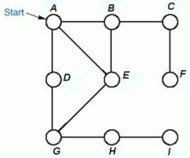
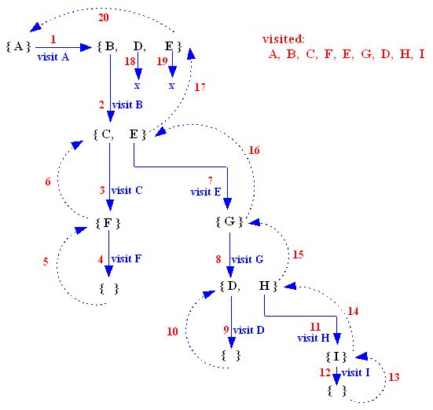
Recursive preorder Depth-First Traversal Tracing
At each stage, a set of unvisited adjacent vertices of the current vertex is generated.
The Preorder Depth First Tree:

Slide 14
Recursive postorder Depth-First Traversal Implementation
dfsPostorder(v){
mark v;
for(each neighbour w of v)
if(w is not marked)
dfsPostorder(w);
visit v;
}
The following is the code for the recursive postorderDepthFirstTraversal method of the AbstractGraph class:
public void postorderDepthFirstTraversal(Visitor visitor,
Vertex start)
{
boolean visited[] = new boolean[numberOfVertices];
for(int v = 0; v < numberOfVertices; v++)
visited[v] = false;
postorderDepthFirstTraversal(visitor, start, visited);
}

Slide 15
Recursive postorder Depth-First Traversal Implementation (cont’d)
private void postorderDepthFirstTraversal(
Visitor visitor, Vertex v, boolean[] visited)
{
if(visitor.isDone())
return;
// mark v
visited[getIndex(v)] = true;
Iterator p = v.getSuccessors();
while(p.hasNext()){
Vertex to = (Vertex) p.next();
if(! visited[getIndex(to)])
postorderDepthFirstTraversal(visitor, to, visited);
}
// visit v
visitor.visit(v);
}

Slide 16
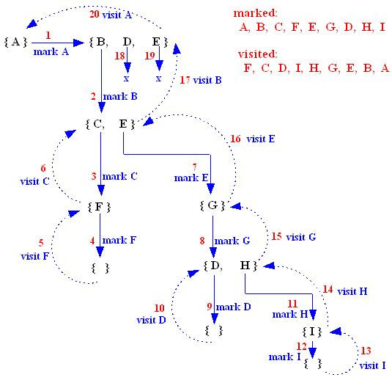
Recursive postorder Depth-First Traversal Tracing
At each stage, a set of unmarked adjacent vertices of the current vertex is generated.
The PostOrder Depth First Tree:

Slide 17
Analysis of DFS
For a Graph G=(V, E) and n = |V| and m=|E|
When Adjacency List is used
  Complexity is O(m + n)
When Adjacency Matrix is used
  Scanning each row for checking the connectivity of a Vertex is in order O(n).
  So, Complexity is O(n²)
DFS uses space O(|V|) in the worst case to store the stack of vertices
on the current search path as well as the set of already-visited vertices.

Slide 18
Connected Components (CCs)
The connected components of an undirected graph are the separate ``pieces'' of the graph such that there is no connection between the pieces.
Connected components can easily be found using depth-first search or breadth-first search. Anything we discover during this search must be part of the same connected component. We then repeat the search from any undiscovered vertex (if one exists) to define the next component, until all vertices have been found:
dfsAllVertices(G)
{
c = 0; /* component number */
for (i = 0; i < numberOfVertices; i++)
if (vertex_{i} is not visited) {
c++;
output("Component ” + c);
dfsPreorder(G, vertex_{i});
}
}

Slide 19
DFS Numbering
Let G be a directed or undirected graph.
Let T_{i} be a DFS (Depth First Search) tree.
Let d[v] be the discovery time and f[v] be the finishing time of a vertex v of G. The first timestamp d[v] records when v is first discovered, and the second timestamp f[v] records when the search finishes examining v's adjacent vertices.
The following algorithm builds DFS tree(s) of a graph G and calculates the discovery and finishing times of
each vertex: dfsAllVertices(G){
    time = 0; // Let time be a global variable
    mark each vertex of G as NOT VISITED;
    for(i = 0; i < numberOfVertices; i++){
    if(vertex_{i} is not visited){
    Add vertex_{i} to tree T_{i};
    dfsPreOrder(vertex_{i}, G, T_{i});
    }
    }
    }
    dfsPreOrder(v, G, T){
    visit(v);
    mark v as VISITED;
    d[v] = ++time;
    for(each neighbour w of v){
    if(w is NOT VISITED){
    add edge (v, w) to tree T;
    dfsPreOrder(w, G, T);
    }
    f[v] = ++time;
    }
}

Slide 20
Strongly Connected Components (SCCs)
A strongly connected component in a directed graph G = (V, E) is a maximal set of vertices such that for every pair of vertices u and v in the component, vertices u and v are reachable from each other.
If G = (V, E) is a directed graph, its transpose, G^{T} = (V, E^{T}) is the same as G with all arrows reversed.
KOSARAJU’S ALGORITHM FOR FINDING SCCs of a graph G:
Call dfsAllVertices(G) to compute finishing time for each vertex
Create the transpose of G i.e., G^{T}
Call dfsAllVertices(G^{T}) but this time consider the vertices in order of decreasing
finish time [i.e, start at the vertex with highest finish time, then next highest etc.]
Output the vertices of each tree in the DFS-forest of step 3 as a separate strongly connected component
The complexity of this algorithm is twice the time of DFS ( G ) which is O ( | V | + | E | )
Note: G and G^{T} have the same Strongly Connected Components

Slide 21
Strongly Connected Components (Cont’d)
We can translate Kosaraju’s algorithm to the following algorithm:
  Perform a DFS on G, each time a vertex is assigned finish time, push it in a stack S
  Create G^{T}, the transpose of G
  Initialize each vertex in G^{T} as not visited
  while(stack S is not empty){
    Pop a vertex v from S
    If(v is not visited){
      Mark v as visited
      dfsPreOrder(v, GT) // mark each unvisited reachable vertex as visited
      Output all visited vertices in the above dfs as a strongly connected component
      }
    }

Slide 22
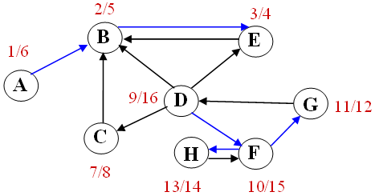
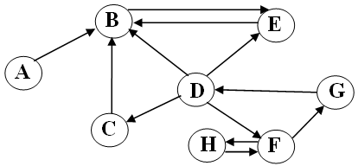

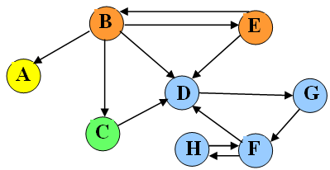
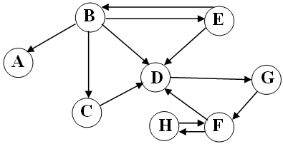
Strongly Connected Components (Cont’d)
Example: Find the SCCs of the graph below. Use A as the start vertex and DFS
traversal:
Perform dfsAllVertices(G) and
compute the discovery and finish times of each vertex, push each finished vertex in a stack:
2. Create G^{T}
3. Perform dfsAllVertices(G^{T}) in decreasing order
of finish times obtained in step (1). Pop a vertex
from the stack; start a traversal from the vertex if it
has not been visited; output all reachable unvisited
vertices in each traversal as a strongly connected
component
DFS(D) = {D, F, G, H}, DFS(C) = {C}, DFS(A) = {A}, DFS(B) = {B, E}

Slide 23
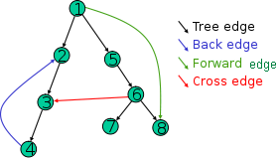
Graph Edge Classification using DFS
Let G be a directed graph.
Let T_{i} be a DFS (Depth First Search) tree for G. Note: G
may have one or several DFS trees.
We can classify edges on G as:
• Tree-Edge is an edge in a DFS tree.
• Back-Edge is a non-tree edge from a vertex u to a proper
ancestor of u in a DFS tree.
Note: Self loops in directed graphs are considered to be back edges.
• Forward-Edge is a non-tree edge from a vertex u to a proper descendant of u in a
DFS tree.
• Cross-Edge is a non-tree edge that connects vertices in two different DFS-trees or
two vertices in the same DFS-tree neither of which is the ancestor nor the
descendant of the other.
Note:
  The way we classify the edges is not unique; it depends on what node we start from
  and in what order the algorithm happens to select successors to visit.
  Forward- and Cross-Edges only apply to directed graphs; this implies in a
  DFS tree of an undirected graph G, every edge of G is either a tree edge or a
  back edge.

Slide 24
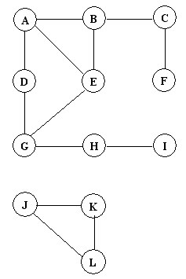
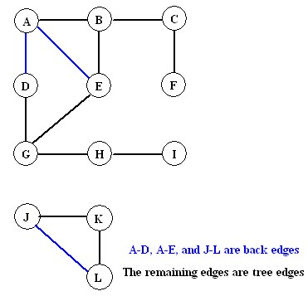
Edge Classification using DFS (Cont’d)
Example1: Classify the edges in the following disconnected undirected graph. Use vertex A as the starting vertex. If at any point in the DFS search it is possible to visit more than one vertex, visit the vertices in increasing alphabetical order.

Slide 25
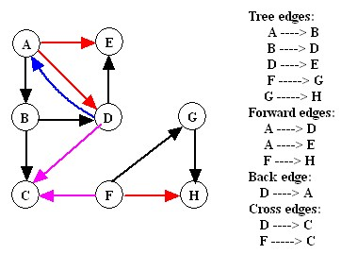
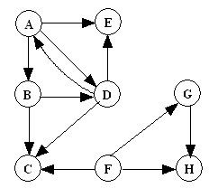
Edge Classification using DFS (Cont’d)
Example2: Classify the edges in the following directed graph. Use vertex A as the starting vertex. If at any point in the DFS search it is possible to visit more than one vertex, visit the vertices in increasing alphabetical order.

Slide 26
Edge Classification using DFS (Cont’d)
DFS can be modified to classify edges as it encounters them
During the traversal the discovery and finish times are computed and vertices are colored
as:
  white: if the vertex is not visited
  gray: when the vertex is first encountered during the traversal
  black: if the vertex and all its adjacent vertices have been visited
An edge e = (v, w) is classified based on the color of vertex w when e is first explored:
Tree edge – if w is white
  Back edge – if w is gray
  Forward or cross - if w is black:
  Forward edge – if w is black and d[v] < d[w] (w was discovered after v)
  Cross edge – if w is black and d[v] > d[w] (v discovered after w)

Slide 27
Edge Classification using DFS (Cont’d)
The DFS Edge classification algorithm for directed graphs:
dfsAllVertices(G){
color all vertices white;
time = 0;
for( each v ∈ V)
if (color[v] == “white”) DFS(v);
}
DFS(v){
color[v] = “gray”;
d[v] = ++time;
[previsit(v)]
for (each w adjacent to v){
if(w is white) edge(v, w).Type = “treeEdge”;
else if(w is gray) edge(v, w).Type = “backEdge”;
else if(d[v] < d[w]) edge(v, w).Type = “forwardEdge”; // w is black
else edge(v, w).Type = “crossEdge”; // w is black
if (color[w] == “white”){
[ Add edge (v, w) to DFS tree]
DFS(w)
}
}
f[v] = ++time;
[postvisit(v)]
color[v] = “black”;
}

Slide 28
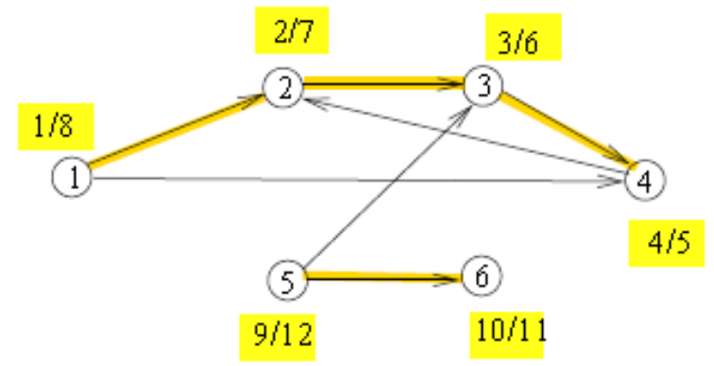
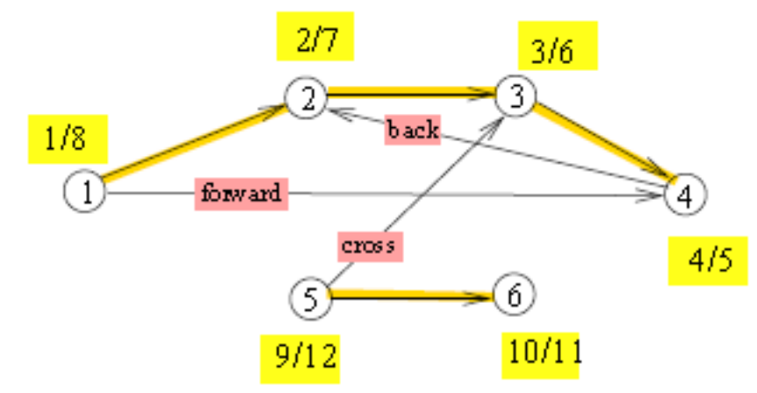
Edge Classification using DFS (Cont’d)
Exercise: Run the DFS edge classification algorithm on the following graph, starting at vertex 1, to obtain the classification given below:

Slide 29
Edge Classification using BFS
BFS classifies edges as follows:
  Directed Graphs
    tree edges, back edges, and cross edges [There are no forward edges]
  Undirected Graphs
    tree edges and cross edges
Compare this classification with that of DFS classification:
  Directed Graphs:
    tree edges, back edges, forward edges, and cross edges
  Undirected Graphs:
    tree edges and back edges
BFS has the useful feature that its tree edges from a given vertex s define paths from s that have a minimum number of edges.
Exercise: Repeat Example1 and 2 in slides 24 and 25 using BFS

Slide 30
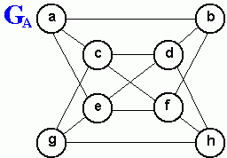
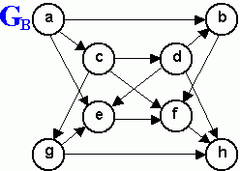
Review Questions
1. Consider a depth-first traversal of the undirected graph G_{A} shown above, starting from vertex a.
  List the order in which the nodes are visited in a preorder traversal showing the depth-first traversal tree.
  List the order in which the nodes are visited in a postorder traversal
2. Repeat exercise 1 above for a depth-first traversal starting from vertex d.
3. List the order in which the nodes of the undirected graph G_{A} shown above are visited by a breadth first traversal that starts from vertex a, showing the breadth-first traversal tree. Repeat this exercise for a breadth-first traversal starting from vertex d.
4. Repeat Exercises 1 and 3 for the directed graph G_{B}.

